Slide 1
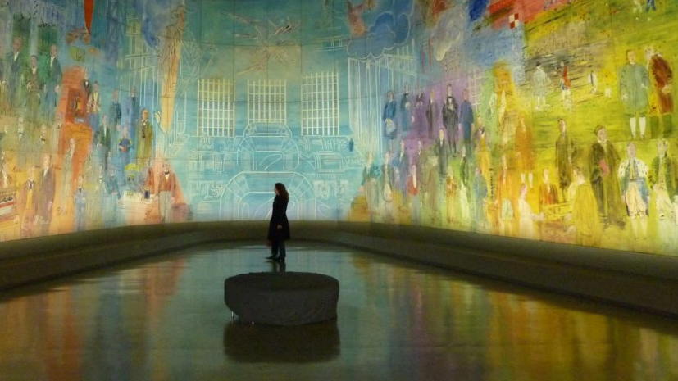
Art + Tech
ANKIT KUMAR
Notes:
https://money.cnn.com/2018/02/14/technology/crypto-art-valentines-day/index.html

Slide 2
Chain of blocks…
What we have discussed in till now !!!
A blockchain is a public, shared database that records transactions between two parties. Blockchains document and confirm owners at a particular time through cryptography. After a transaction is validated and cryptographically verified by other participants or nodes in the network, it is made into a "block" on the blockchain.
A block contains information about the time the transaction occurred, previous transactions, and details about the transaction. Once recorded as a block, transactions are ordered chronologically and cannot be altered. This technology rose to popularity after the creation of Bitcoin—the first application built on using blockchain technology—and has catalyzed other cryptocurrencies and applications.
Notes:
QuickStarter has created an outline to help you get started on your presentation. Some slides include information here in the notes to provide additional topics for you to research.

Slide 3
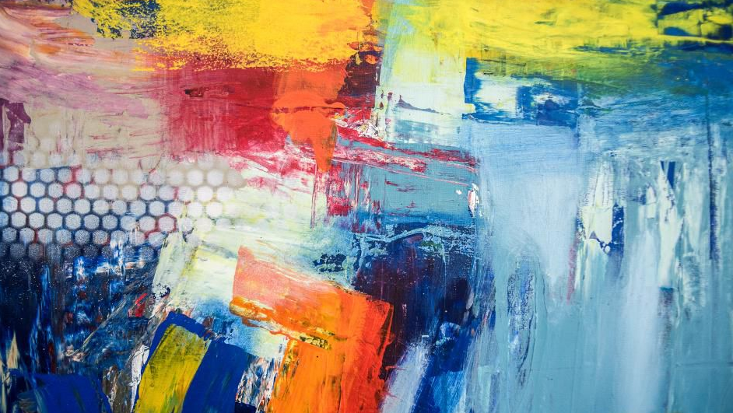
2018-19 has brought both highs and lows to the art market. Auction records were broken, confidence levels wavered, paintings were shredded, and social media continued to change the artist’s role in the industry.
BLOCKCHAIN & the world of ARTs
FORBES
Notes:
QuickStarter has created an outline to help you get started on your presentation. Some slides include information here in the notes to provide additional topics for you to research.
https://www.pbs.org/newshour/show/how-blockchain-technology-could-revolutionize-the-art-market

Slide 4
"Potato #345" in 2016 for more than $1 million.
crypto-art rose titled "Forever Rose“ sells for $1 million
Visual artists are increasingly creating digital artwork, which might not ever have a physical presence
Simplified transactions
Increased transparency
Increased trust
Increased security
Sharable, immutable data
Empowered users
WHY?
Notes:
Digital files, however, can be replicated and distributed without the artists’ consent. By registering their work on the blockchain, artists can establish proof of ownership, and therefore a secondary market
get 1/10 of the ROSE, an ERC20 token on the Ethereum blockchain.
Abosch and GIFTO, a decentralized universal gifting protocol.
https://www.dpreview.com/news/6617425004/crypto-art-forever-rose-photo-sells-for-1m-making-it-the-world-s-most-valuable-virtual-art

Slide 5
Transparency
track ownership and provenance
provide an infrastructure for the tokenization of fractional artwork sales
finding works of art of sufficient quality to hold their value
Standardization
Regulation and governance
Challenges

Slide 6
Fungible tokens
When something is fungible, in this case a token, it means it can be easily replaced by something identical – and it is interchangeable with ease
A lot of the time, fungible tokens are built using a standard called ERC-20
Fungible tokens are divisible – meaning you can send a fraction of one ERC-20 token.

Slide 7
Non fungible tokens
when something is nonfungible they are uniquely different ..
The two items may look to be identical at a glance, each will have unique information or attributes that make them irreplaceable or impossible to swap.
One physical example of a nonfungible asset could be a plane ticket. Sure, they look the same as other tickets, but each one has different passenger names, destinations, departure times and seat numbers. Exchanging yours with someone could have serious consequences – not only could you end up thousands of miles away from where you wanted to be, airport security might not be too impressed either.

Slide 8
advantages and disadvantages
Nonfungible tokens allow you to detail more of the attributes that make them special – far beyond the name, balance, token supply and symbol. This is because you can include rich metadata about an asset and include information about ownership – and these authenticated details can ultimately add value because investors can be confident about its provenance.
That said, there are downsides. Nonfungible tokens have not been embraced as speedily as some advocates hoped, in part because the ERC-721 protocol is so new. It can also be tricky and time consuming to develop decentralized applications for non-fungible tokens properly.

Slide 9
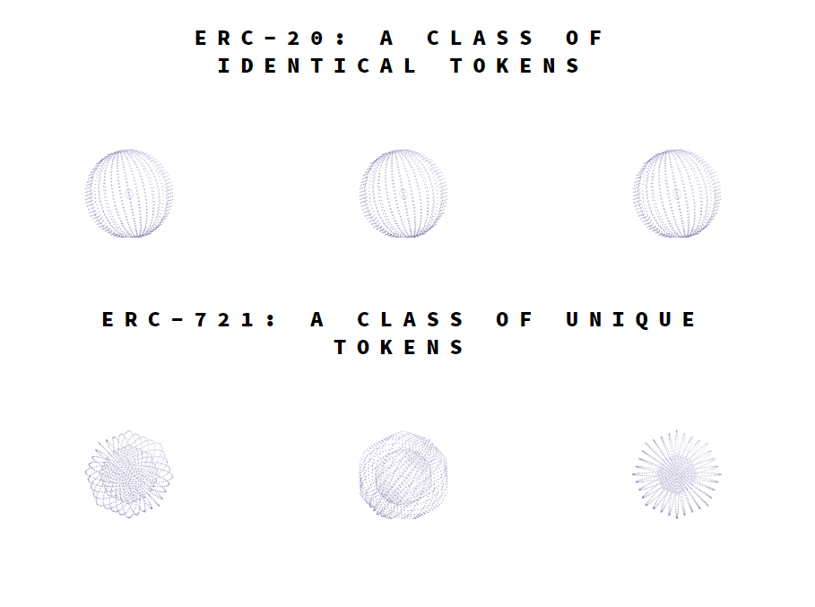
ERC-721 Non-Fungible Token Standard
A standard interface for non-fungible tokens, also known as deeds.
ERC-721 is a free, open standard that describes how to build non-fungible or unique tokens on the Ethereum blockchain. While most tokens are fungible (every token is the same as every other token), ERC-721 tokens are all unique. Think of them like rare, one-of-a-kind collectables. nonfungible ERC-721 tokens cannot be divided and must be bought or sold whole
The standard allows for the implementation of a standard API for NFTs within smart contracts. This standard provides basic functionality to track and transfer NFTs.
We considered use cases of NFTs being owned and transacted by individuals as well as consignment to third party brokers/wallets/auctioneers (“operators”).
As they can hold mete data , NFTs can represent ownership over digital or physical assets. We considered a diverse universe of assets, and we know you will dream up many more:
- Physical property — houses, unique artwork
-Virtual collectables — unique pictures of kittens, collectable cards
-“Negative value” assets — loans, burdens and other responsibilities
Notes:
https://eips.ethereum.org/EIPS/eip-721

Slide 10
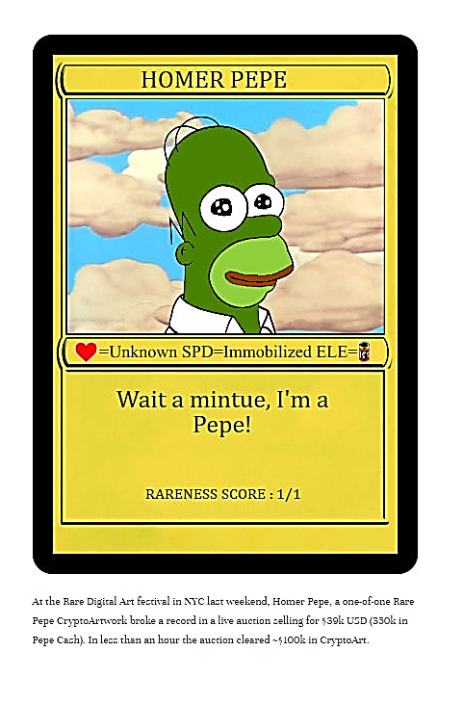
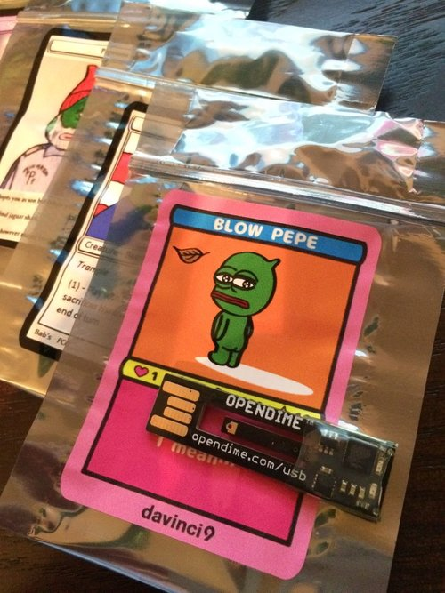
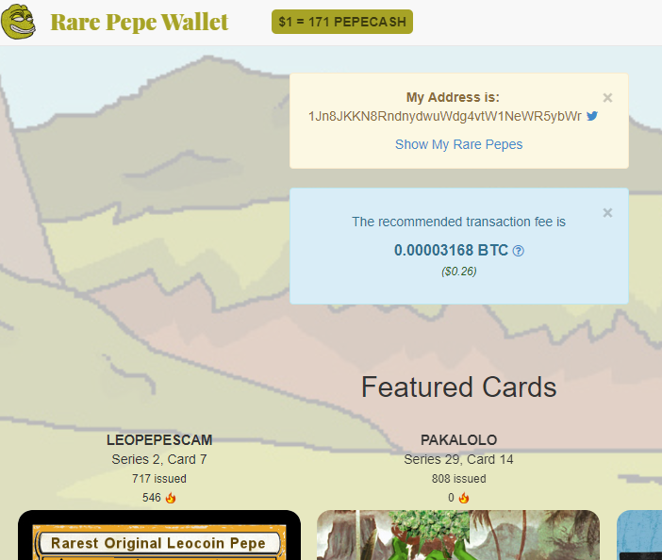
Rare Pepe Wallet
people spent $1.2M on tokens associated with drawings of green frogs.
Notes:
https://www.artnome.com/news/2018/1/23/rare-pepe-wallet-the-birth-of-cryptoart

Slide 11
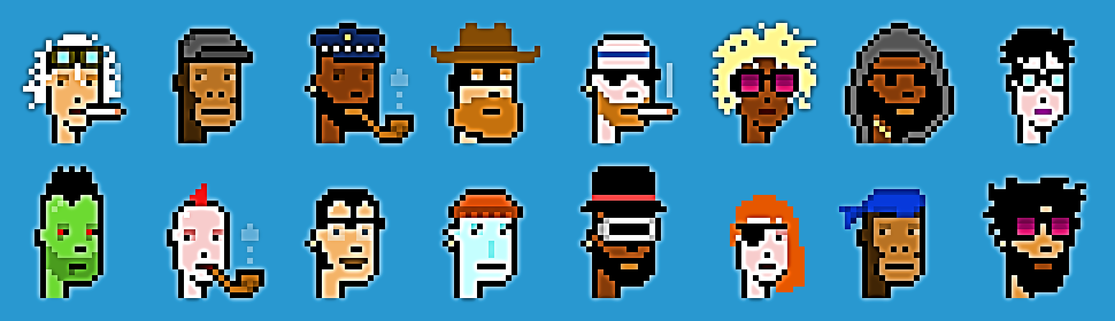
CryptoPunks
ERC-721 standard
10,000 unique collectible characters with proof of ownership stored on the Ethereum blockchain
Currently showing at the ZKM Center for Art and Media in Karlsruhe, Germany as part of the Open Codes Exhibition
Overall Stats
Estimated Market Cap
Total Value of All Sales
Average Sale Price
1.32KΞ ($234.55K)
2.78KΞ ($493.06K)
0.43Ξ ($76.90)
Notes:
running CryptoPunks! Once we released it onto the blockchain it became permanently embedded there and can no longer be modified by anyone. This is scary for us as developers because we worry about bugs, but it is also a very powerful feature of the system. It allows a user verify that there are indeed only 10,000 punks, check that we can't steal them from you

Slide 12
Choon
Choon is a music streaming service and digital payments ecosystem—designed to solve the music industry’s most fundamental problems.
12,744
Artists Earning Notes
46,917
Tracks
191.2M
Notes Earned By Artists

Slide 13
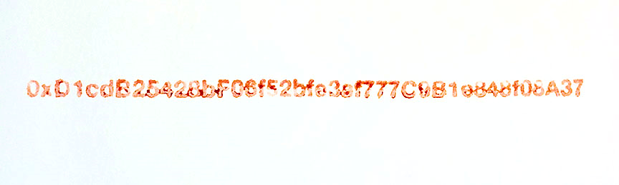
IAMA Coin project
ERC-20 token
IAMA Coin (or I am a coin) is a collection of both physical and digital artwork by Kevin Abosch.
created 100 physical pieces of art and tied them to the Ethereum blockchain with “virtual art”.
Blood stamped every piece of physical art with the contract address for the creation of the IAMA that exist on the Ethereum network
divisible up to 18 decimal places
https://www.iamacoin.com/about.html
Notes:
Where can I buy IAMA?
Unfortunately, you can’t purchase IAMA tokens just yet. Abosch is first making the virtual artwork available to existing collectors and afterward, to the general public. He hasn’t stated a date on when this will be, though. However, looking at the wallet activity, it appears that he’s already made some transactions with a few collectors.
Who is Kevin Abosch?
Kevin Abosch is a popular Irish artist and photographer. He’s worked with such notable people as Johnny Depp, Yoko Ono, and Malala Yousafzai. His most valuable work, though, is a photograph of a potato. Potato #345 sold for one million euros to a European businessman – one of the most expensive photographs ever purchased.
Even without his potato payday, Abosch has had a fairly lucrative career. His iconic, black background portraits start at $150,000 and can run up to well over half a million dollars.
Abosch wasn’t always an artist, though. He first began his career as a biologist with a passion to learn new technologies. His first photography gig was while he was working at CBS Records. The company needed someone to photograph a band, and Abosch threw his hat in the ring. After trying for a $5,000 paycheck, he negotiated down to $2,500 for the work. With that baseline set, he continued to take on more jobs and the rest is history.

Slide 14
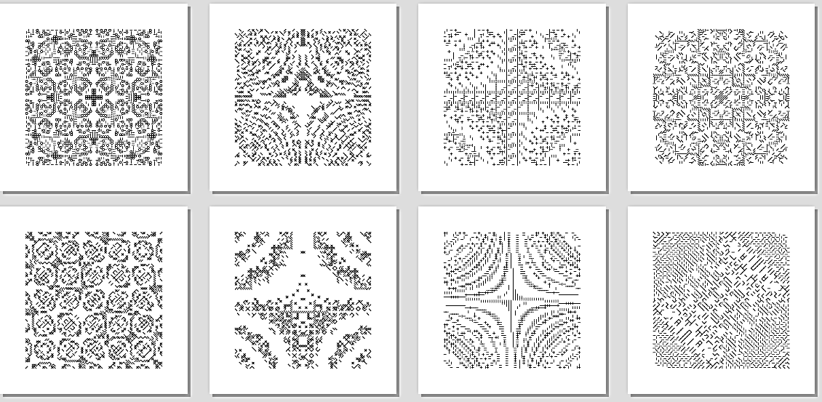
Autoglyphs
ERC-721 standard
“on-chain” generative art on the Ethereum blockchain
ERC-721 interface. While ERC-721 is the standard for “non-fungible tokens” it is generally used to manage ownership of digital items stored elsewhere. The key difference with the Autoglyphs is that the art is inside the contract itself, it is literally “art on the blockchain.”
for an example. It doesn't look like much as hex data, but it encodes a character art pattern. This pattern can then be drawn to a screen or even on paper by following the written instructions in the comments of the smart contract itself.

Slide 15
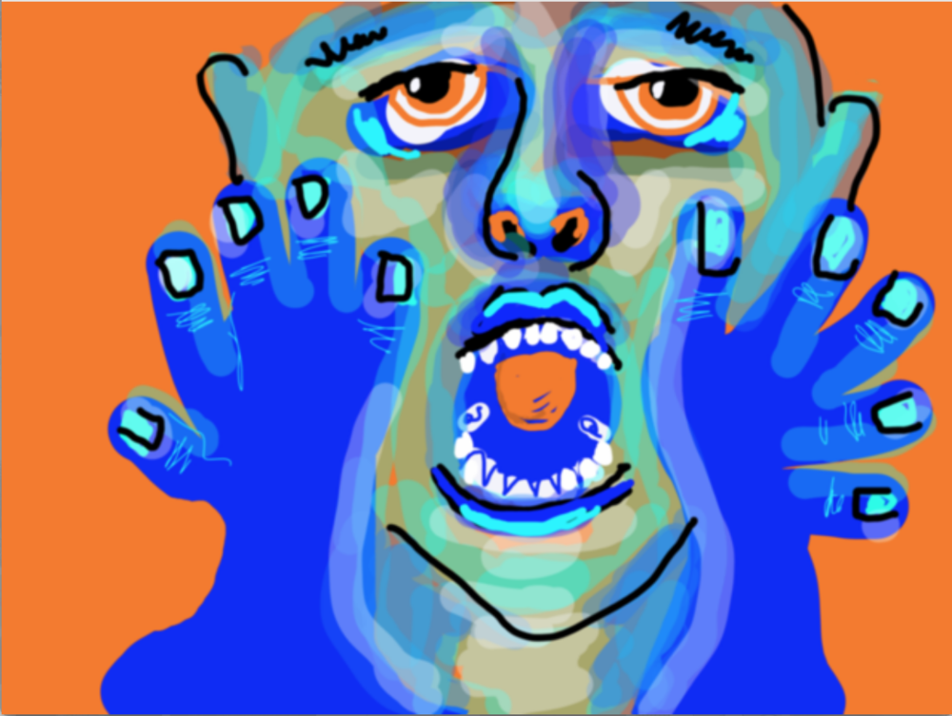
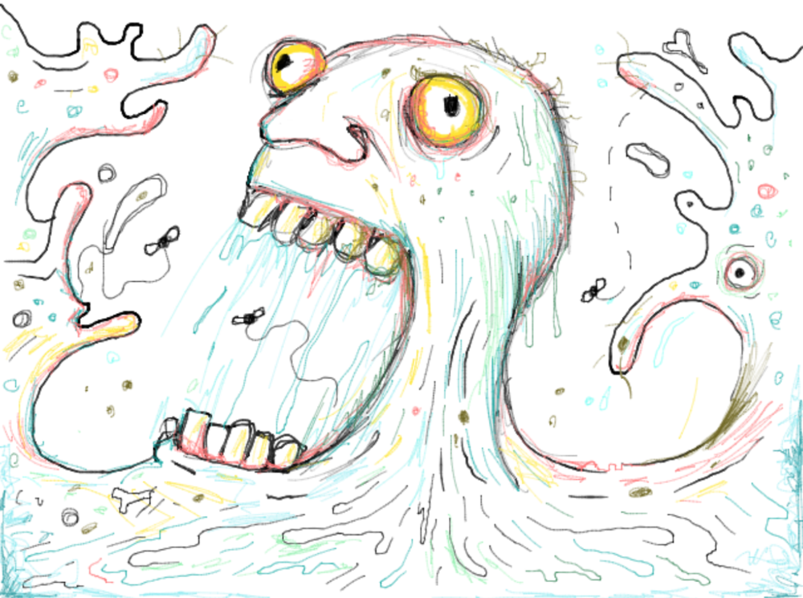
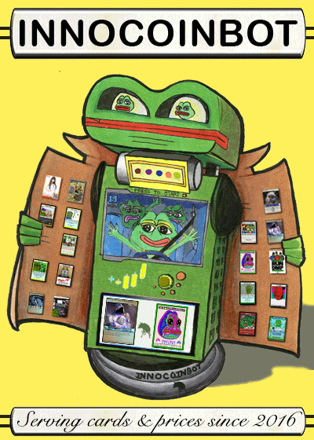
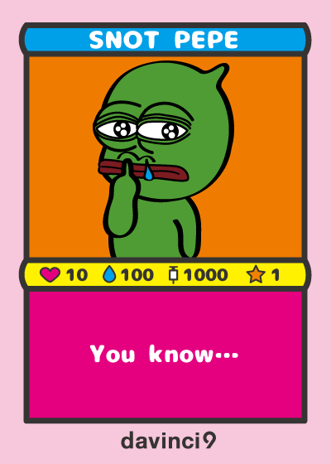
WHY CRYPTO ART
Digitally Native: For the first time, artwork can be created, editioned, bought, and sold digitally.
Geographically Agnostic: Empowered by the internet, artists participate from all over the world. CryptoArt is the first truly global art movement.
Democratic/Permissionless: Everyone is encouraged to participate regardless of skills, training, class, gender, race, age, creed, etc.
Decentralized: Tools and guidelines are designed to reduce the power of gatekeepers and middlemen and increase the autonomy of artists.
Anonymous: Use of pseudonyms allows artists to create and sell art while staying anonymous (if preferred), freeing them from social judgment.
Memetic: CryptoArt are often literally memes valued for their ability to spread quickly. The difference? The "Meme Economy" is now a reality.
Self-Referential: CryptoArtists often play with references to key events and personalities within cryptocurrency and blockchain culture.
CryptoPatrons: CryptoArt is collected by the CryptoRich: a group of savvy technologists and investors who got into cryptocurrency early.
Pro-Artist: Blockchain platforms often take little to no commission from artists. Artists are often remunerated for every future sale of a single work.
Dankness: Because CryptoArt is open to everyone, judging it by traditional artistic standards kills what is great about it. Instead, it is best to judge CryptoArt by "dankness" or potency of expression and creativity.
Notes:
https://www.artnome.com/news/2018/1/14/what-is-cryptoart

Slide 16
WHY ETHEREUM
Bitcoin is designed just to transact and store ownership of Bitcoin itself.
ETHEREUM, a successor to Bitcoin for arbitrary computer code to be executed on the blockchain and the results of the execution to be stored forever.
Ethereum lets everyone execute the code, show each other what result they got, and agree that the code was executed properly and fairly.
Notes:
Normally code is run on a server somewhere and you basically need to trust the person running the server.

Slide 17
Platforms
For auctions of art works
R A R E art - https://rareart.io/
CRYPTOPUNKS - https://www.larvalabs.com/cryptopunks
PORTION -https://portion.io/
For provenance tracking :
Deloitte developed ArtTracktive

Slide 18
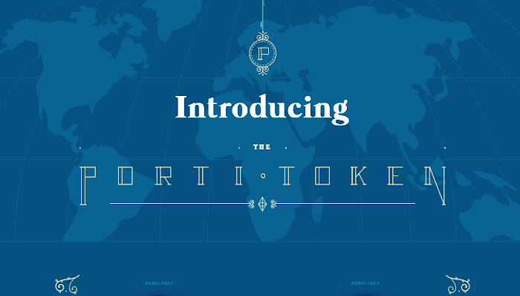
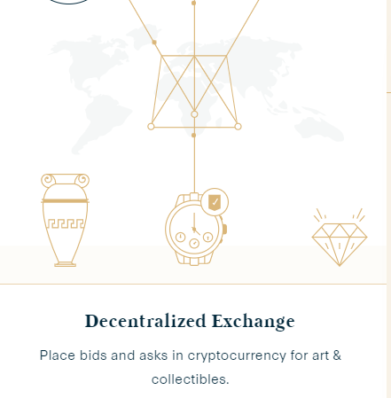
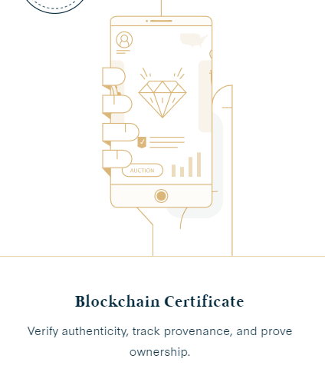
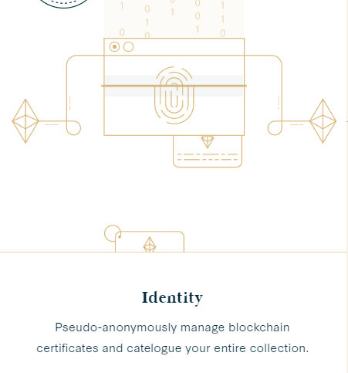
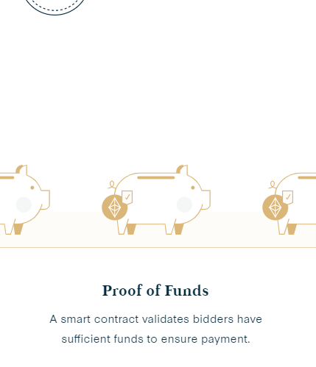
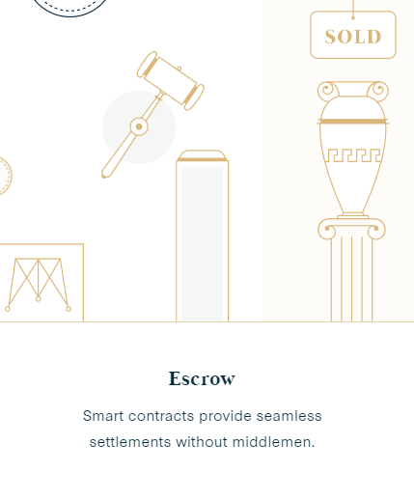
PORTION
A full suite of financial services
Ability to auction both digital and physical goods (Portion’s first platform will offer digital art from renowned artists)
Transacting in Ethereum, but users who choose to use Portion’s proprietary “Porti” token will eliminate all third parties, intermediaries, and fees
Blockchain-based smart contracts to validate proof of funds to avoid situations where bidders default after submitting winning bids that exceed their actual funds
Validation of identity through distributed technologies

Slide 19

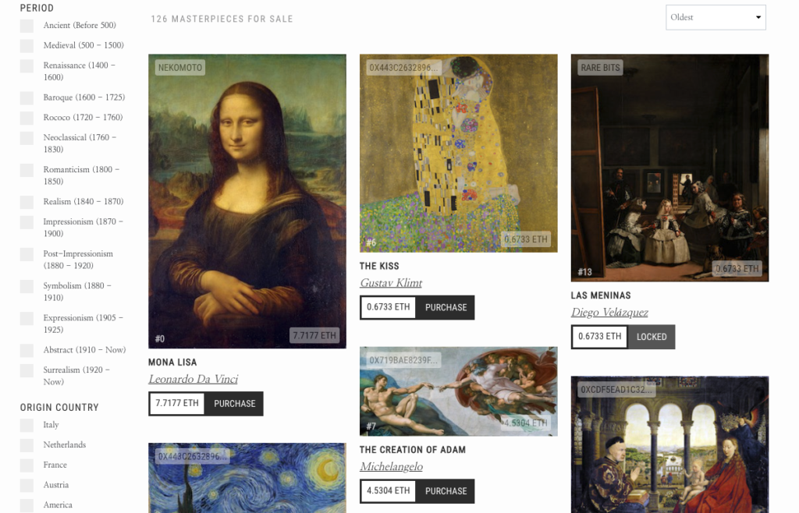

Slide 20
What are the advantages of collecting digital blockchain art vs traditional physical art?
here's so many things you can do because it's like, what can you do with a physical piece of art or collectible or trading card. It's very minimal to what you can do with a digital one because you have so many options now with how you can interact with it.
blockchain brings necessary transparency to transactions, which could potentially disrupt the art world.The art world has a history of being reluctant to make pricing and ownership available to the public. Since every transaction on blockchain is available on a single public ledger, each artwork leaves a traceable trail of pricing history and change of ownership.

Slide 21

the question, “Where do we draw the line for what we consider art?”
Notes:
As technology and traditional art continue to merge, the line between the two is becoming increasingly blurry. In the end, it’s really up to your own thought process. If skyscrapers and homes, once considered to be just functional structures, are now widely known as works of art, why can’t the blockchain be too?

